Slide 1


JAVA Java Interview boot camp Core concepts
Lecture 20
CHAPTER 39
JODA API

Slide 2
JODA API
(New Date Time API)

Slide 3
Today’s Agenda
New Date Time API
Introduction
Why New Date Time API Was Introduced ?
Important Date Time Classes

Slide 4
Introduction To Java 8 Date Time API
Java 8 introduced new classes for date and time to resolve the long-standing issues of existing APIs: java.util.Date and java.util.Calendar.
These newly introduced immutable-value classes are easy-to-use, well-documented, and thread-safe.

Slide 5
Why Was Date Time API Introduced ?
Prior to Java 8 , the 2 classes used for handling dates were java.util.Date and java.util.Calendar.
Both these classes have following drawbacks:
Not very powerful
No built in support for Time
No support for Time Zone
Not thread safe

Slide 6
Important Date Time Classes
The new Date and Time API is packaged under 2 important packages:
java.time
java.time.*

Slide 7
Important Date Time Classes
Following are it’s most commonly used classes:
LocalDate: Used to encapsulate a date without time
LocalTime: Used to encapsulate a time without date
LocalDateTime : Used to encapsulate both date and time
ZoneId: Used for time zone information
ZonedDateTime : Used to encapsulate both date and time

Slide 8
The LocalDate Class
Available in the package java.time.
Used to represent date in ISO format (yyyy-MM-dd)
An instance of this class is immutable and represents date without information of the time and timezone.
We can use it’s various static factory method to create an instance of this class.

Slide 9
Getting Today’s Date
To create an instance of current date from the system clock, we can use the static method called now() of the class LocalDate .
LocalDate today = LocalDate.now();
System.out.println("Today's Local date : " + today);
Output:
Today's Local date : 2021-02-01

Slide 10
Getting A Particular Date
We can also create a date from any arbitrary date by using another useful factory method called of() belonging to the class LocalDate.
This method takes a year, month and date and returns an equivalent LocalDate instance
LocalDate dateOfBirth = LocalDate.of(1978, 12, 22);
System.out.println(“My Date of birth is : " + dateOfBirth);
Output:
My Date of birth is: 1978-12-22

Slide 11
Another Way Of Getting A Particular Date
We can also convert a String value to LocalDate object provided the String is in the ISO date format.
To do this we can use another useful factory method called parse() belonging to the class LocalDate.
This method takes a String of the format yyyy-MM-dd and returns an equivalent LocalDate instance
LocalDate dateOfBirth = LocalDate.parse(“1978-12-22”);
System.out.println(“My Date of birth is : " + dateOfBirth);
Output:
My Date of birth is: 1978-12-22

Slide 12
Getting Current Day, Month And Year
The LocalDate class has convenient methods to extract year, month, the day of the month and several other date attributes from an instance of LocalDate class.
By using these methods, we can get whatever property of date we want.
LocalDate today = LocalDate.now();
int year = today.getYear();
int month = today.getMonthValue();
int day = today.getDayOfMonth();
System.out.println("Year :”+year+”Month :”+month+” Day :”+ day);
Output:
Year: 2021 Month:2 Day:1

Slide 13
Other Utility Methods Of LocalDate Class
The LocalDate class offers various utility methods that can be used to perform different types of calculations.
Adding Or Subtracting Days
Adding Or Subtracting Months
LocalDate today = LocalDate.now();
LocalDate tomorrow = today.plusDays(1);
LocalDate yesterday = today.minusDays(1);
LocalDate today = LocalDate.now();
LocalDate nextMonth = today.plusMonths(1);
LocalDate prevMonth = today.minusMonths(1);

Slide 14
Other Utility Methods Of LocalDate Class
Adding Or Subtracting Years
Checking For Leap Year
LocalDate today = LocalDate.now();
LocalDate nextYear = today.plusYears(1);
LocalDate lastYear = today.minusYears(1);
LocalDate today = LocalDate.now();
boolean result=today.isLeapYear();

Slide 15
Other Utility Methods Of LocalDate Class
Comparing Dates
LocalDate date1=LocalDate.now();
LocalDate date2=LocalDate.of(2020,3,20);
LocalDate date3=LocalDate.of(2020,3,21);
System.out.println(date1+" and "+date2 +" are equal:"+
date1.equals(date2));
System.out.println(date1+" comes before "+date3 +":"+
date1.isBefore(date3));
System.out.println(date1+" comes after "+date3 +":"+
date1.isAfter(date3));
Output:
2020-03-20 and 2020-03-20 are equal:true
2020-03-20 comes before 2020-03-21:true
2020-03-20 comes after 2020-03-21:false

Slide 16
The LocalTime Class
Available in the package java.time.
Used to represent time in ISO format (hh:mm:ss:nn)
An instance of this class is immutable and represents time without information of the date and timezone.
We can use it’s various static factory method to create an instance of this class.

Slide 17
Getting Current Time
To create an instance of current time from the system clock, we can use the static method called now() of the class LocalTime .
LocalTime currTime = LocalTime.now();
System.out.println("Current time is:"+currTime);
Output:
Current time is:11:32:11.470

Slide 18
Getting A Particular Time
We can also create a time from any arbitrary time by using another useful factory method called of() belonging to the class LocalTime.
This method is overloaded and takes a hour, min or hour, min , sec and returns an equivalent LocalTime instance
LocalTime evening=LocalTime.of(16,0);
System.out.println("Evening time is:"+evening);
LocalTime night=LocalTime.of(21,30,50);
System.out.println(“Night time is:"+night);
Output:
Evening time is:16:00
Night time is:21:30:50

Slide 19
Another Way Of Getting A Particular Time
We can also convert a String value to LocalTime object using the factory method called parse() belonging to the class LocalTime.
This method takes a String of the format hh:mm or hh:mm:ss and returns an equivalent LocalTime instance
LocalTime evening=LocalTime.parse("16:00");
System.out.println("Evening time is:"+evening);
LocalTime night=LocalTime.parse("21:30:50");
System.out.println("Night time is:"+night);
Output:
Evening time is:16:00
Night time is:21:30:50

Slide 20
Getting Current Hour, Minute And Second
The LocalTime class has convenient methods to extract hour, minute, the seconds from an instance of LocalTime class.
By using these methods, we can get whatever property of time we want.
LocalTime currTime = LocalTime.now();
int hour = currTime.getHour();
int min = currTime.getMinute();
int sec = currTime.getSecond();
System.out.println("Hour:"+hour+“ Min:"+min+“ Sec:"+sec);
Output:
Hour:11 Min:55 Sec:16

Slide 21
Other Utility Methods Of LocalTime Class
The LocalTime class offers various utility methods that can be used to perform different types of calculations.
Adding Or Subtracting Hours
Adding Or Subtracting Minutes
LocalTime currTime = LocalTime.now();
LocalTime nextHour = currTime.plusHours(1);
LocalTime pastHour = currTime.minusHours(1);
LocalTime currTime = LocalTime.now();
LocalTime nextMin = currTime.plusMinutes(1);
LocalTime prevMin = currTime.minusMinutes(1);

Slide 22
Other Utility Methods Of LocalTime Class
Adding Or Subtracting Seconds
LocalTime currTime = LocalTime.now();
LocalTime nextSec = currTime.plusSeconds(1);
LocalTime prevSec = currTime.minusSeconds(1);

Slide 23
Other Utility Methods Of LocalTime Class
Comparing Times
LocalTime time1=LocalTime.now();
LocalTime time2=LocalTime.of(17,49,25);
LocalTime time3=LocalTime.of(18,15,30);
System.out.println(time1+" and "+time2 +" are equal:"+
time1.equals(time2));
System.out.println(time1+" comes before "+time3 +":"+
time1.isBefore(time3));
System.out.println(time1+" comes after "+time3 +":"+
time1.isAfter(time3));
Output:
17:49:10.848 and 17:49:25 are equal:false
17:49:10.848 comes before 18:15:30:true
17:49:10.848 comes after 18:15:30:false

Slide 24
The LocalDateTime Class
Available in the package java.time.
Used to represent both local date and time without timezone information.
The format is (yyyy-MM-ddThh:mm:ss.nnn)
We can use it’s various static factory method to create an instance of this class.

Slide 25
Getting Current Date And Time
To create an instance of LocalDateTime from the system clock, we can use the static method called now() of the class LocalDateTime .
LocalDateTime current = LocalDateTime.now();
System.out.println("Current date and time is:"+current);
Output:
Current date and time is:2020-03-20T18:02:46.509

Slide 26
Getting A Particular Date And Time
We can also create an instance of LocalDateTime for an arbitrary date and time by using another useful factory method called of() belonging to the class LocalDateTime.
This method is overloaded and takes an year,month,day, hour, min and optional sec and nanosecond and returns an equivalent LocalDateTime instance
LocalDateTime dt1=LocalDateTime.of(2020,8,15,6,5);
System.out.println("Morning time is:"+dt1);
LocalDateTime dt2=LocalDateTime.of(2020,8,15,16,25,9);
System.out.println("Evening time is:"+dt2);
Output:
Morning time is:2020-08-15T06:05
Evening time is:2020-08-15T16:25:09

Slide 27
Another Way Of Getting A Particular Date Time
We can also convert a String value to LocalDateTime object using the factory method called parse() belonging to the class LocalDateTime.
This method takes a String of the format yyyy-MM-ddThh:mm or hh:mm:ss.nnn and returns an equivalent LocalDateTime instance
LocalDateTime dt1=LocalDateTime.parse("2020-08-15T06:05");
System.out.println("Morning time is:"+dt1);
LocalDateTime dt2=LocalDateTime.parse("2020-08-15T06:25:09");
System.out.println("Evening time is:"+dt2);
Output:
Morning time is:2020-08-15T06:05
Evening time is:2020-08-15T06:25:09

Slide 28
Getting Current Hour, Minute And Second
The LocalDateTime class has convenient methods to extract year,month,day, hour, minute, the seconds from an instance of LocalDateTime class.
By using these methods, we can get whatever property of date and time we want.

Slide 29
Getting Current Hour, Minute And Second
LocalDateTime current=LocalDateTime.now();
int day=current.getDayOfMonth();
int month=current.getMonthValue();
int year=current.getYear();
int hour=current.getHour();
int min=current.getMinute();
int sec=current.getSecond();
System.out.println("day:"+day+",month:"+month+",year:"+year);
System.out.println("hour:"+hour+",min:"+min+",sec:"+sec);
Output:
day:20,month:3,year:2020
hour:19,min:25,sec:3

Slide 30
Other Utility Methods Of LocalDateTime Class
The LocalDateTime class offers various utility methods that can be used to perform different types of calculations.
Adding Or Subtracting Hours
Adding Or Subtracting Minutes
LocalDateTime current = LocalDateTime.now();
LocalDateTime nextHour = current.plusHours(1);
LocalDateTime pastHour = current.minusHours(1);
LocalDateTime current = LocalDateTime.now();
LocalDateTime nextMin = current.plusMinutes(1);
LocalDateTime prevMin = current.minusMinutes(1);

Slide 31
Other Utility Methods Of LocalDateTime Class
Adding Or Subtracting Seconds
Similarly we have same methods for adding and subtracting date components like days, months and years just like LocalDate class.
LocalDateTime current = LocalDateTime.now();
LocalDateTime nextSec = current.plusSeconds(1);
LocalDateTime prevSec = current.minusSeconds(1);

Slide 32
Other Utility Methods Of LocalDateTime Class
Comparing Dates And Times
LocalDateTime dt1=LocalDateTime.now();
LocalDateTime dt2=LocalDateTime.of(2020,3,20,17,49,25);
LocalDateTime dt3=LocalDateTime.of(2020,4,21,18,15,30);
System.out.println(dt1+" and "+dt2 +" are equal:"+
dt1.equals(dt2));
System.out.println(dt1+" comes before "+dt3 +":"+
dt1.isBefore(dt3));
System.out.println(dt1+" comes after "+dt3 +":"+
dt1.isAfter(dt3));
Output:
2020-03-20T19:40:21.086 and 2020-03-20T17:49:25 are equal:false
2020-03-20T19:40:21.086 comes before 2020-04-21T18:15:30:true
2020-03-20T19:40:21.086 comes after 2020-04-21T18:15:30:false

Slide 33
Formatting Date And Time
Date formatting is done with the help of DateTimeFormatter class and format() methods in date time classes.
To create a DateTimeFormatter object we call its static factory method called ofPattern(), whose prototype is:
public static DateTimeFormatter ofPattern(String pattern)

Slide 34
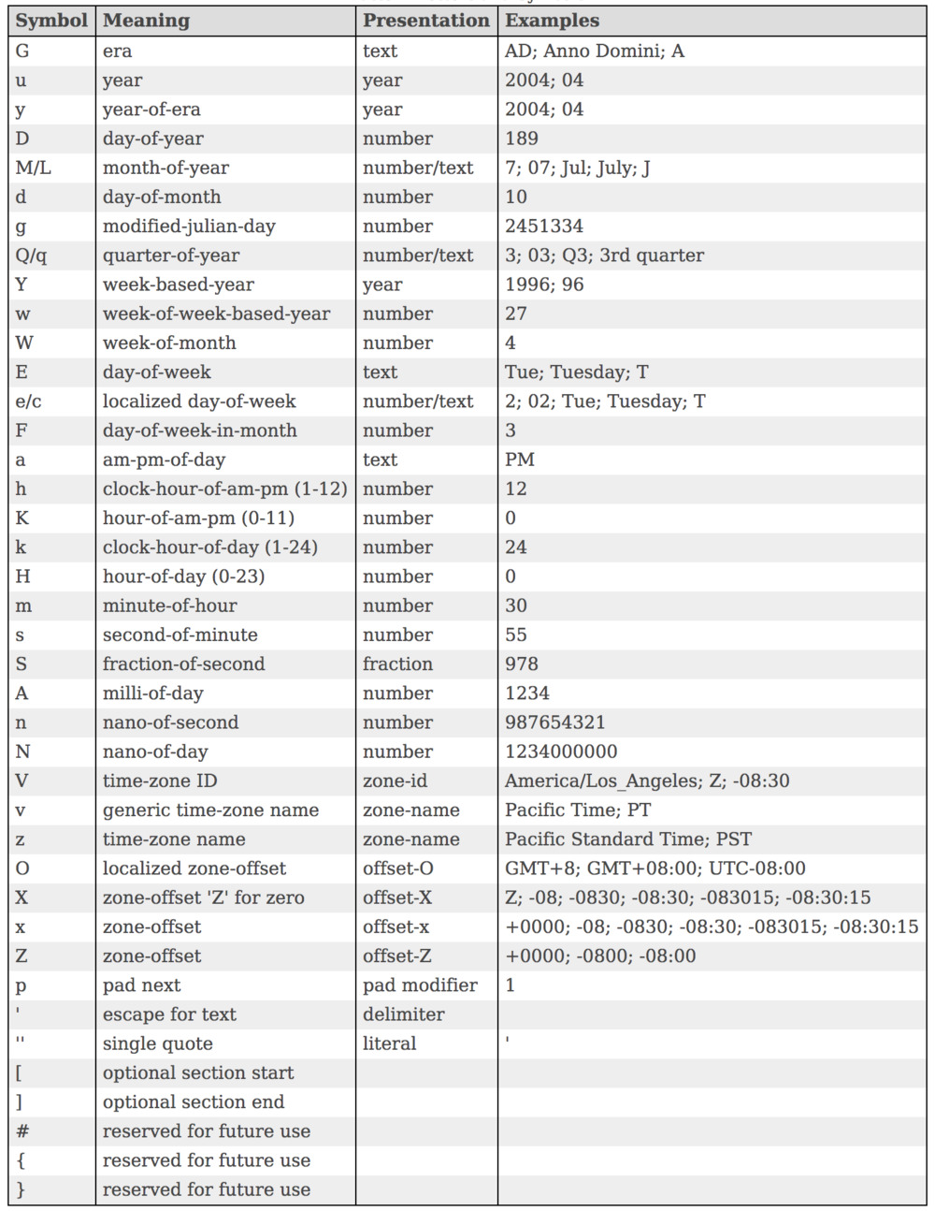
Available Patterns

Slide 35
Changing Date Format
import java.time.LocalDate;
import java.time.format.DateTimeFormatter;
public class FormatDate {
public static void main(String[] args) {
LocalDate today=LocalDate.now();
System.out.println("Default format of LocalDate:"+today);
DateTimeFormatter fmt=DateTimeFormatter.ofPattern("dd-MMM-yyyy");
String dateStr=today.format(fmt);
System.out.println("Formatted date is:"+dateStr);
}
}
Output:
Default format of LocalDate:2021-01-27
Formatted date is:27-Jan-2021

Slide 36
Changing Time Format
import java.time.LocalTime;
import java.time.format.DateTimeFormatter;
public class FormatTime {
public static void main(String[] args) {
LocalTime curr=LocalTime.now();
System.out.println("Default format of LocalTime:"+curr);
DateTimeFormatter fmt=DateTimeFormatter.ofPattern(“hh:mm:ss a");
String timeStr=curr.format(fmt);
System.out.println("Formatted time is:"+timeStr);
}
}
Output:
Default format of LocalTime:11:36:36.425
Formatted time is:11:36:36 am

Slide 37
Changing Both Date & Time Format
import java.time.LocalDateTime;
import java.time.format.DateTimeFormatter;
public class FormatDateTime {
public static void main(String[] args) {
LocalDateTime today=LocalDateTime.now();
System.out.println("Default format of LocalDateTime:"+today);
DateTimeFormatter fmt=DateTimeFormatter.ofPattern("dd-MMM-yyyy hh:mm:ss a");
String dateTimeStr=today.format(fmt);
System.out.println("Formatted date and time time is:"+dateTimeStr);
}
}
Output:
Default format of LocalDateTime:2021-01-27T11:41:23.102
Formatted date and time time is:27-Jan-2021 11:41:23 AM

Slide 38
Parsing Date
Although the LocalDate provide us a method called parse() for converting String to LocalDate object , but this method expects the date to be passed in its default format which is yyy-MM-dd .
However with the help of DateTimeFormatter class we can pass a string of any date format to parse() method for getting converted to LocalrDate

Slide 39
Parsing Date
import java.time.LocalDate;
import java.time.format.DateTimeFormatter;
public class ParseDate {
public static void main(String[] args) {
LocalDate independence1=LocalDate.parse("1947-08-15");
System.out.println(independence1);
DateTimeFormatter fmt=DateTimeFormatter.ofPattern("dd-MMM-yyyy");
LocalDate independence2=LocalDate.parse("15-Aug-1947",fmt);
System.out.println(independence2);
}
}
Output:
1947-08-15
1947-08-15

Slide 40
The ZonedDate And Time API
The Java 8 new date and time API allows us to deal with situations where we need the timezone information.
The important classes of this purpose are:
ZoneId
ZonedDateTime

Slide 41
The ZoneId Class
Available in the package java.time.
Represents an identifier that is used to identify different timezones.
There are around 40 different timezones provided by ZoneId.

Slide 42
Getting A ZoneId Instance
To create an instance of ZoneId we can use the static method called of() of the class ZoneId
This method accepts a String representation of a zone as argument and returns a ZoneId object
ZoneId paris = ZoneId.of("Europe/Paris");
ZoneId calcutta = ZoneId.of("Asia/Calcutta");
System.out.println(paris);
System.out.println(calcutta);
Output:
Europe/Paris
Asia/Calcutta

Slide 43
Getting All Available Zones
To get all available zones, we can call the static method of the class ZoneId called getAvailabeZoneIds().
This method returns a Set of ZoneId represented as String.
Set<String> allZones=ZoneId.getAvailableZoneIds();
allZones.forEach(str->System.out.println(str));
Output:
Asia/Aden
America/Cuiaba
.
.

Slide 44
The ZonedDateTime Class
Available in the package java.time.
Represents a date and time with time zone information
ZonedDateTime is an immutable representation of a date-time with a time-zone.

Slide 45
Getting A ZonedDateTime Instance
To create an instance of ZonedDateTime we can use its static factory method called now()
ZonedDateTime zonedDateTime = ZonedDateTime.now();
System.out.println(zonedDateTime);
Output:
2021-01-27T12:19:06.681+05:30[Asia/Calcutta]

Slide 46
Getting A ZonedDateTime Instance
import java.time.LocalDate;
import java.time.Month;
import java.time.ZoneId;
import java.time.ZonedDateTime;
public class ZonedDateTimeEx {
public static void main(String[] args) {
ZonedDateTime zoneDateTime = ZonedDateTime.now();
System.out.println("current date time with zone: "+zoneDateTime);
// get date alone
LocalDate d1 = zoneDateTime.toLocalDate();
System.out.println("current date: " + d1);
// get zone info
ZoneId zone = zoneDateTime.getZone();
System.out.println("zone info: " + zone.getId());

Slide 47
Getting A ZonedDateTime Instance
// extract date properties
Month mnt = zoneDateTime.getMonth();
System.out.println("Month: "+mnt.getValue());
int dayOfMonth = zoneDateTime.getDayOfMonth();
System.out.println("Day of the month: "+dayOfMonth);
int year = zoneDateTime.getYear();
System.out.println("Year: "+year);
// extract time properties
int hour = zoneDateTime.getHour();
System.out.println("current hour: "+hour);
int minutes = zoneDateTime.getMinute();
System.out.println("current minutes: "+minutes);
int seconds = zoneDateTime.getSecond();
System.out.println("current seconds: "+seconds);
}
}

Slide 48
Getting A ZonedDateTime Instance
Output:
current date time with zone: 2021-01-27T12:24:09.194+05:30[Asia/Calcutta]
current date: 2021-01-27
zone info: Asia/Calcutta
Month: 1
Day of the month: 27
Year: 2021
current hour: 12
current minutes: 24
current seconds: 9

